Slide 1
A Community Health, Education and Recreation Resource of California Hospital Medical CenterA Community Education, Health and Recreation
Resource of California Hospital Medical Center
EARLY HEAD START FAMILY CHILDCARE PARTNERSHIP PROGRAM
ANNUAL REPORT
2018

Slide 2
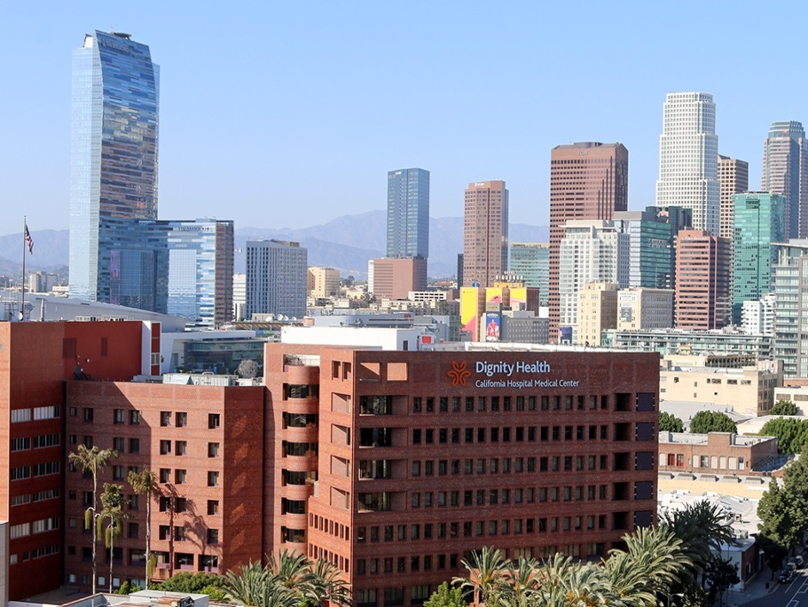
California Hospital Medical Center
The mission of California Hospital Medical Center is to:
Deliver compassionate, high quality, affordable health services;
Provide direct services to those who are poor and disenfranchised and to advocate on their behalf;
Partner with others in the community to improve the quality of life.
“Health is more than not being sick; it is well-being in mind, body, and community“
California Hospital Medical Center (CHMC), a non-profit community teaching hospital, has been serving the needs of central and downtown Los Angeles since 1887. As one of our city’s major birthing centers, delivering nearly 4,000 infants each year, CHMC has long been considered a center of excellence in its work with pregnant women, infants, and children.

Slide 3
The mission of the Hope Street Early Head Start Program is to:
Enhance the capacity of parents and families to nurture and care for their children.
Promote children’s overall health, development, school readiness, and academic achievement.
Strengthen existing service delivery networks and foster community partnerships, by developing services that are accessible and responsive to the community we serve.
Hope Street’s Early Head Start Program was established in 1997 as a collaboration between California Hospital Medical Center and the University of California, Los Angeles. Located adjacent to the hospital campus, our Early Head Start program provides a continuum of early care and education, health and nutrition, mental health, disabilities, and family services that support young children and their families.

Slide 4
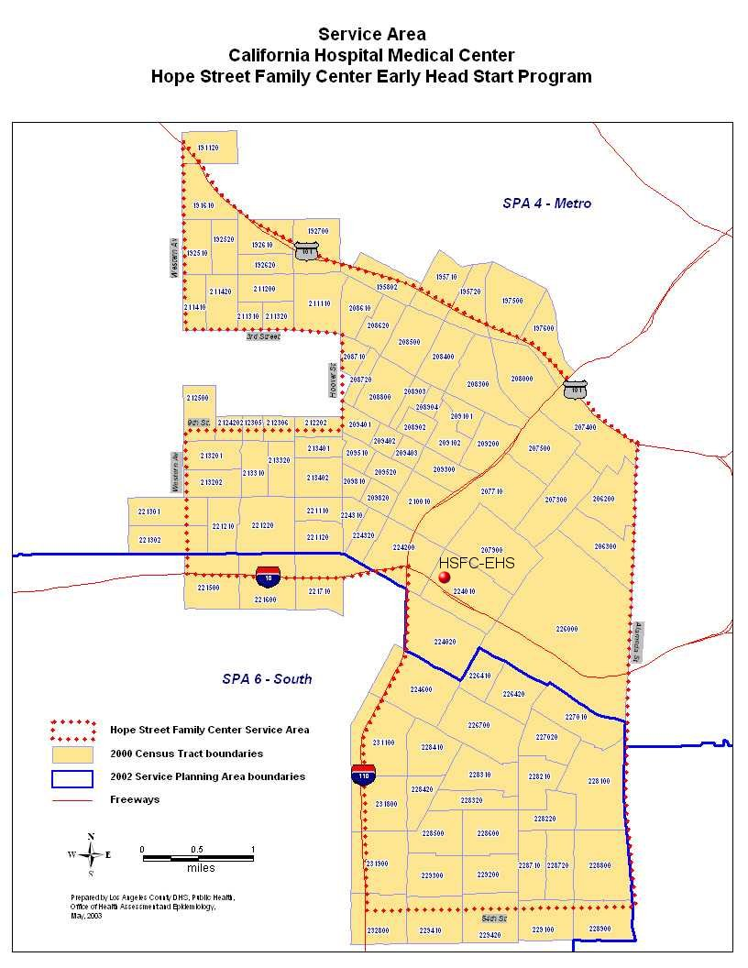
Service Area:
The EHS geographic area is roughly bounded on the north by the 101 Freeway; on the east by Alameda Street; on the south by 54th Street; and on the west by the 110 Freeway to the 10 Freeway to Western Ave. to 9th St. to Hoover St. to 3rd St. and to Western Ave.

Slide 5
Community Needs Assessment
Indicator | HSFC-EHS Service Area | Los Angeles County
Income/Poverty
Households with annual incomes under $25,000 | 45% | 24%
Families with children living in poverty | 29% | 12%
Children 0-4 year living in poverty | 22,823 (47%) | 168,867 (27%)
Educational Attainment
Adults with less than a 9th grade education | 29% | 14%
Ethnicity/Language
Population that is Latino | 69% | 49%
Primary language spoken at home is Spanish | 68% | 40%
Health/Prenatal Care
Preterm Births | 11% | 10%
Prenatal Care in First Trimester | 77% | 82%
Infant Death Rate (per 1,000 live births) | 5.6 | 4.6
Childhood Disabilities
Children with identified disabilities, 0-17 years | 3.6% | -
Childcare Shortfall of spaces for children 0-3 | 434 | -
Hope Street Services & Community Networks
Community Needs Assessment 2016

Slide 6
EHS CCP Overview
EHS CCP program provides full-day, year-round EHS Family Childcare Partnership services for 16 low-income pregnant women and families with young children, 0‑4 years of age. Services are provided in partnership with licensed community childcare providers and the California Department of Education.
Enrollment priorities include children with special needs, children in foster care, homeless families, teen parents, and non-English speaking parents.
Working in close partnership with families, our multidisciplinary team of teachers, home visitors, nurses, social workers and psychologists foster children’s development and enhance the quality of life for families - ensuring access to a comprehensive network of services, many of which are located on or adjacent to the CHMC campus.

Slide 7
EHS Child Care Partnership (CCP) Program Enrollment
EHS Childcare Partnership services are provided on a full-day, year-round basis, within licensed family childcare homes.

Slide 8
EHS CCP Mental Health & Disabilities Services
Ten percent (10%) of EHS-CCP children had a disability, meeting the required minimum of 10%.
.

Slide 9
EHS CCP Health Services Report
Children and pregnant women with an ongoing source of continuous, accessible health insurance and healthcare | 100%
Children up-to-date on a schedule of prevention and primary healthcare | 92%
Children diagnosed with chronic condition needing treatment Anemia Asthma Hearing difficulties Vision problems | 0%
Children who received or are receiving medical treatment for identified conditions | 0%
Children with up-to-date immunizations | 96%
Children with up-to-date preventative oral health care | 92%
Pregnant women receiving prenatal health care | 100%
2018 PIR Data

Slide 10
School Readiness
Goals
Children will learn about themselves
Children will learn about their feelings
Children will learn about others
Children will learn about communicating
Children will acquire thinking skills
Children will learn about moving and doing
Our Philosophy
School readiness is rooted in the interactions that young children have with their caregivers and early environments.
Our Approach
We provide a continuum of health, mental health, family support, and early childhood education services that improves children’s environments, promotes early development, and supports parents in their role as their child’s first teacher

Slide 11
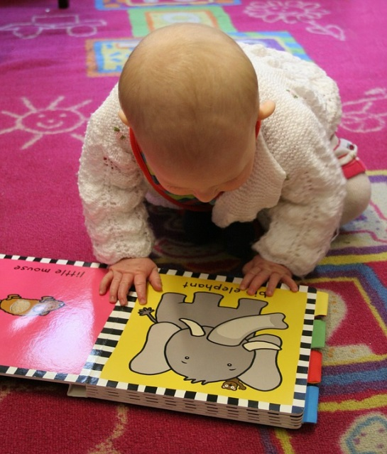
School Readiness
Desired Outcomes: Healthy physical, cognitive, social, language, and emotional development
Children’s progress in each developmental domain is assessed on a quarterly basis and is used for instructional planning and to individualize early care and education services for each child.
Desired Results Developmental Profile (2015) quarterly mean domain subscale scores demonstrate children’s competency in meeting and exceed target mastery goals.

Slide 12
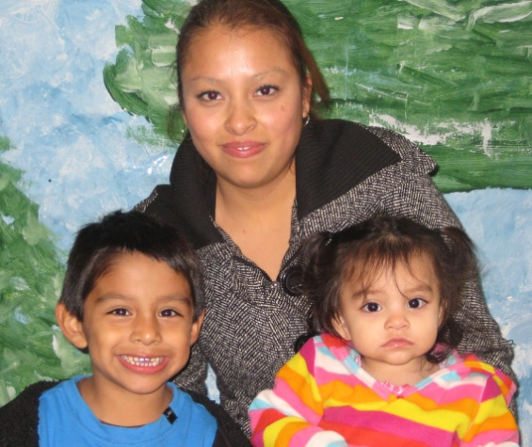
Parent Involvement Opportunities
Volunteering within the EHS program and California Hospital Medical Center
Family Literacy Classes
Socialization
Educational Workshops and Classes
Healthy Lifestyle Activities: Yoga and Cooking Classes
Health, Self Assessment, and Community Assessment Committees
Parent Committee and Policy Council

Slide 13
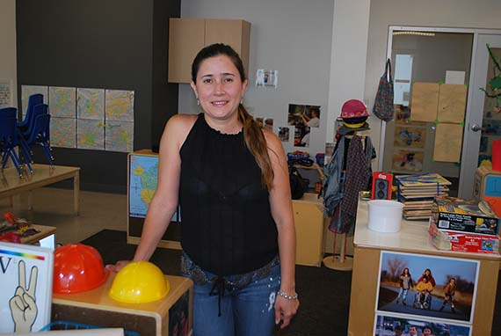
Parent Success Story
As a parent of a child who was born at California Hospital and who has special health challenges, I know how important it is to have excellent care. And once you leave the hospital, when you have a child with special needs, it is so very important to have someone to listen, to help, and who understands. My husband and I desperately needed help with Nicholas– and we will be forever grateful to the Hope Street Margolis Family Center Early Head Start Program for standing by our side during difficult times, for providing excellent services, and for believing in the future of our son.
My son and I attended Family Literacy classes and received home-visits from EHS staff. I have served as the Policy Council President. The education and support that was offered to our family was exactly what we needed.
- Nancy

Slide 14
EHS CCP End of Year Financials
Description | JULY 1, 2017– June 30, 2018
 | Federal Funds | Federal Training | Non-Federal Funds
PERSONNEL
Salaries | $107,559
Fringe Benefits | $31,403
TRAVEL | 0
SUPPLIES | $96,864
TRAINING |  | $8,958
CONTRACTUAL | $55,257
OTHER | $2,207 |  | $82,106
Indirect | $26,176
TOTAL OPERATIONS | $319,466 | $8,958 | $82,106

Slide 15
EHS CCP FY 2018-19 Budget Projections
Description | Federal Funds | Federal Training | Non-Federal Funds
PERSONNEL
Salaries | $115,988
Fringe Benefits | $33,901
SUPPLIES | $34,451
TRAINING | 0 | $7,295
CONTRACTUAL | $175,112
OTHER | $4,516 |  | $100,241
Indirect | $29,700
TOTAL OPERATIONS | $393,668 | $7,295 | $100,241

Slide 16
EHS CCP Federal and Non-Federal Share Budget
HSFC – EHS CCP Program | 2018 -2019
Federal Share Budget Total | $320,608
Non-Federal Share Budget Total | $80,152
Early Head Start CCP Budget Total | $400,760
Audits & Reviews
2018 A133 audit completed
No findings

Slide 17
HOPE STREET MARGOLIS FAMILY CENTER
Early Head Start Program
TEXT HERE

